Slide 1
Canada
Chilled Cannabis not Hot Hemp

Slide 2
Overview
Canadian Constitutional Framework
Cannabis Act
Regulated and Permitted Activities
Genetics

Slide 3
CONSTITUTION
Peace Order and Good Government

Slide 4
Canada’s Constitution
Negotiated while the US Civil War raged
Key concept POGG – Peace, Order and Good Government
Approach – Central Government had the major power to avoid the US States’ Rights issues
Courts – 154 years of jurisprudence turned the approach on its head: the provinces have the bulk of the power.
A very balkanized country

Slide 5
Who Has What?
Federal Government has exclusive jurisdiction over Criminal Law (mens rea offences)
Provinces have exclusive jurisdiction over property & civil rights; matters of a private or local nature
Both assigned jurisdiction over agriculture
Freedom of Expression in the commercial context can be severely restricted: alcohol, tobacco,

Slide 6
CANNABIS ACT
Criminal and Regulatory Law

Slide 7
Cannabis Act
Cannabis was made illegal in 1923
Roots in the Hague Opium Conference 1911-12
Put into the Narcotic Control Act 1961
This was in compliance with the Single Convention on Narcotic Drugs 1961
Medical Access legalized in 2001
Open use made legal in 2018
Production, distribution, sale, possession federal jurisdiction
Retail or consumer falls within provincial jurisdiction
In 2020, edibles, extracts, and topicals became legal

Slide 8
FEDERAL REGULATION – Licensing
Cultivation
indoor / outdoor; 41 outdoor licenses March 2020
Micro-cultivation
Nursery
Processing
Analytical Testing
Medical Purposes
Research

Slide 9
Federal Regulation - Security
Site design
Visual Monitoring
Intrusion Detection & Monitoring
Record Keeping
Restricted Access
Physical Barriers

Slide 10
PACKAGING – Plain Brown Paper Bag?
Restrictions On Alcohol and Tobacco template for Cannabis
No branding
Package is a uniform colour must not be fluorescent or metallic
No hidden features
No image or information
No scent

Slide 11
Cannabis Import / Export Permits
Must be for Medical or Scientific Purposes
To import must be the holder of a licence
To export must be the holder of a licence
Details about intended use; brand, quantity,
Minster may add conditions to permits
Contain THC in a concentration greater than 10 micrograms per gram.
Notes:
Cannabis sector contributes $17 Billion Cdn to the GDP (13.5 US $)
Dairy industry contributes $20 billion cad to the GDP
Legal sales will exceed $4 billion in 2021
Illegal sales estimated at $4 billion
Wine sales are $8 billion p;er annum, beer sales are 9.3 billion per annum

Slide 12
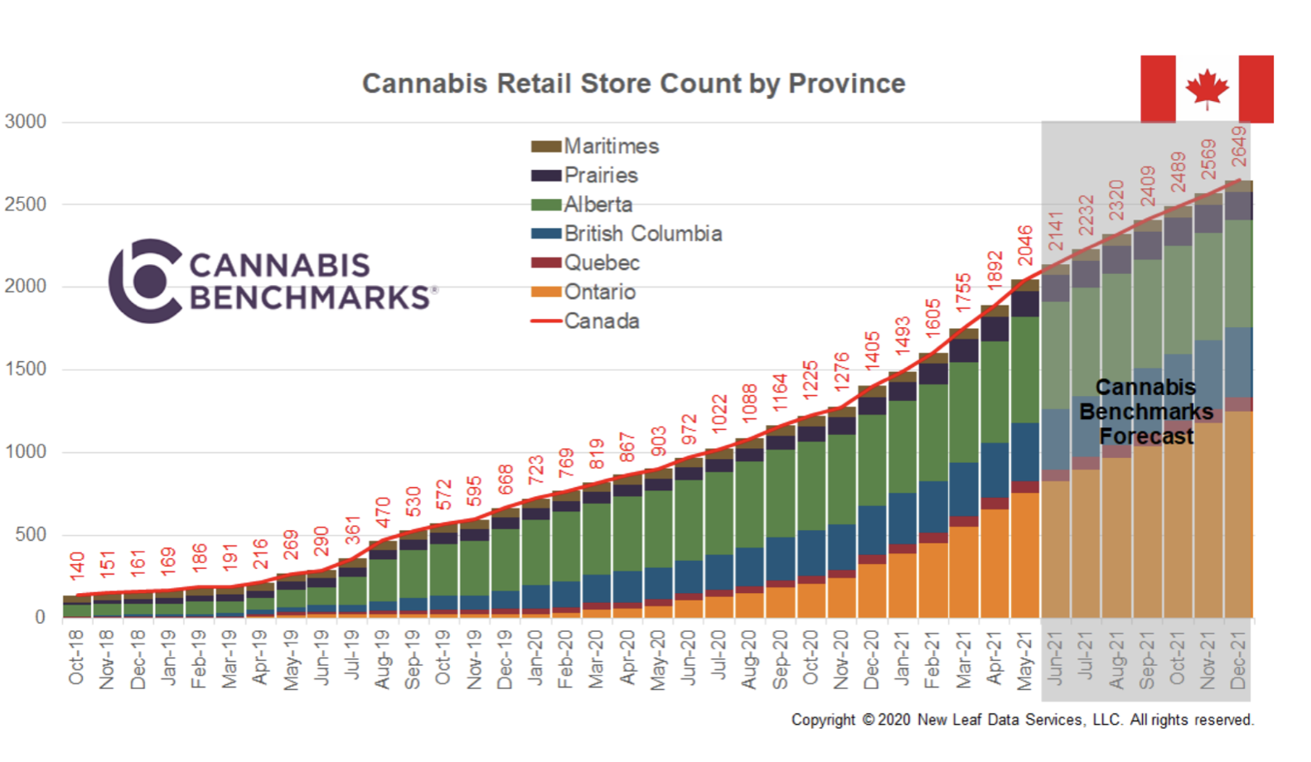
Notes:
The Industrial Hemp Regulations (IHR) define “industrial hemp” as a cannabis plant – or any part of that plant – in which the concentration of THC is 0.3% or less in the flowering heads and leaves.
A licence from Health Canada is required to possess, cultivate, sell/provide, process, produce a derivative, import and/or export industrial hemp.
There are 1603 Starbucks locations in Canada 2020

Slide 13
Intellectual Property
How does one protect a crop?
Notes:
Hemp licences went from 542 in 2018 to 1269 in 2020, with some 22,000 hectares in cultivation (about 54,000 acres)

Slide 14
Cannabis & Hemp IP Protection
GENOTYPE
PHENOTYPE
Patent Act
Composition of Matter (synthetic gene)
Process
No GMO /CRISPR / Mutagenic issuances to date
Numerous cannabis process patents granted and pending
Plant Breeders Rights Act
Distinct, Uniform, Stable; UPOV
Numerous applications submitted; most abandoned
Hemp applications increased and prosecuted to registration

Slide 15
Thank you!
Dr. Stan Benda, BA., LL.B., LL.M., Ph.D.
stanbenda@gmail.com
416 728 4558
Plantlawyer.com
Plantlawyer.wordpress.com

