Slide 1
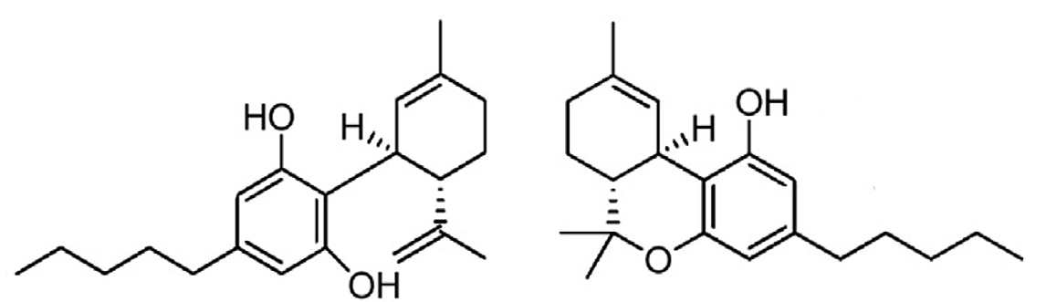
Cannabis Pharmacology
Aidan Hampson PhD.
Special Content Expert on Cannabis
Division of Therapeutics & Medical Consequences
National Institute on Drug Abuse
aidan.hampson@nih.gov
Disclosures:
Any opinions expressed are my own and may/not represent an official position of the National Institute on Drug Abuse.
I am the first author of USPatent #6630507, “Cannabinoids as Antioxidants and Neuroprotectants.”, currently licensed by HHS to Kannalife Sciences”

Slide 2
Cannabinoid Pharmacology
Scope of the Talk
How nerves work and how (endo)cannabinoids affect nerve function.
Compare absorption of cannabis absorption when smoked, vaped or eaten.
Discuss the adverse pharmacological effects of THC.
Report on studies of cannabinoids as therapeutics:
THC as a pain reliever
Cannabidiol in epilepsy
Cannabidiol in anxiety
Final Note: Comparison of solubility of THC/CBD and caffeine.

Slide 3

Neuronal Anatomy
Axonal process
Axon
Myelin sheath (insulation)
Dendrites
Unmyelinated “Node of Ranvier”
Processes connect to dendrites at Synapses

Slide 4
How Nerves Fire
At rest, pumps keep the sodium ion (Na⁺) concentration inside neurons low, and the potassium (K⁺) ion concentration higher than outside
When stimulated, Na⁺ channels in the node open followed by K⁺ channels, causing a “pulse” of charge to enter then exit the neuron.
This pulse of charge is called an “Action Potential” (AP)
+10mV
Na⁺ in
Action Potential
K⁺ out
-70mV
The Na+ induced voltage “spike” causes K+ channels to open and allow K+ out

Slide 5
Signal Transmission
Na⁺
K⁺
Charge moves down an axon like a “chasing light” (not like electrons in a wire)
At Synapses, chemical neurotransmitters propagate the signal to the post synaptic neuron

Slide 6
Neurotransmission at Synapses
At the presynapse, the AP stimulates calcium (Ca²⁺) influx through voltage sensitive channels
Ca²⁺ influx signals release of neurotransmitter vesicles
Neurotransmitters activate post-synaptic receptors to allow Na⁺ and Ca²⁺ in.
This influx of charge re-initiates the AP on the post-synapse

Slide 7
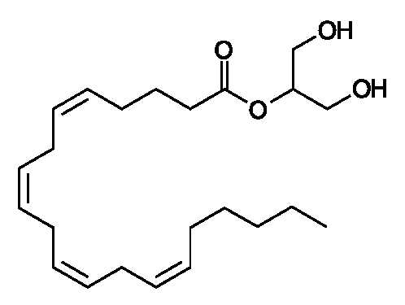
Endocannabinoids
If too many APs occur, excess neurotransmitter spills outside the synapse
Receptors outside of the synapse detect this excess and synthesize the endocannabinoid
2-arachidonyl-glycerol (2AG)
2-arachidonyl glycerol (2-AG)
Volkow, N.D., Hampson, A.J., and Baler, R.D. (2017). Don't Worry, Be Happy: Endocannabinoids and Cannabis at the Intersection of Stress and Reward. Annual review of pharmacology and toxicology 57, 285-308

Slide 8
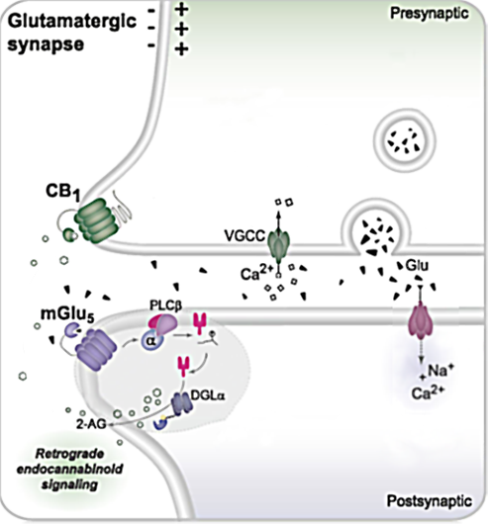
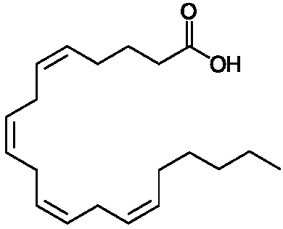
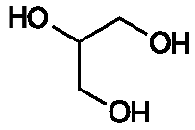
that inhibit the calcium channels
Endocannabinoids regulate Neurotransmission
CB1 releases subunits which inhibit calcium channels and reduce neurotransmission
The enzyme MAGL
breaks down 2-AG
and so restores neurotransmission
2-AG migrates backwards across the synapse to activate pre-synaptic Cannabinoid receptors (CB1)
2-AG modulates neurotransmission where and when needed (unlike THC)
Volkow, N.D., Hampson, A.J., and Baler, R.D. (2017). Don't Worry, Be Happy: Endocannabinoids and Cannabis at the Intersection of Stress and Reward. Annual review of pharmacology and toxicology 57, 285-308

Slide 9
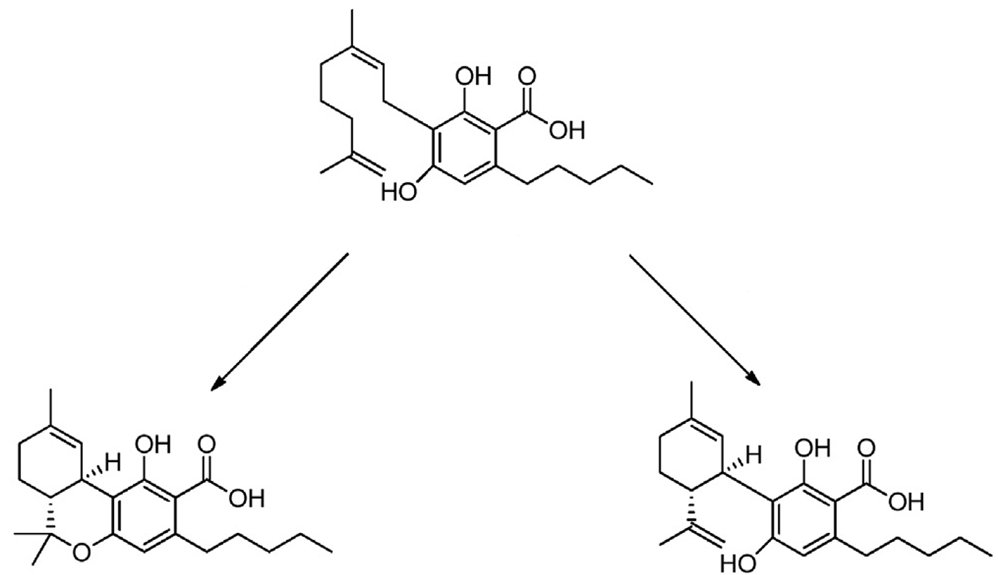
PhytoCannabinoids
1
Cannabinoid Precursor
Cannabigerolic acid
THCA
Synthase
CBDA
Synthase
High in marijuana
High in Hemp
Heat,
Light
THC
CBD

Slide 10
THC / CBD absorption and metabolism: smoking vs eating
Free and Glucuronide Whole Blood Cannabinoids' Pharmacokinetics after Controlled Smoked, Vaporized, and Oral Cannabis Administration in Frequent and Occasional Cannabis Users: Identification of Recent Cannabis Intake. Newmeye et al. Clin Chem. 2016 62(12):1579-1592

Slide 11
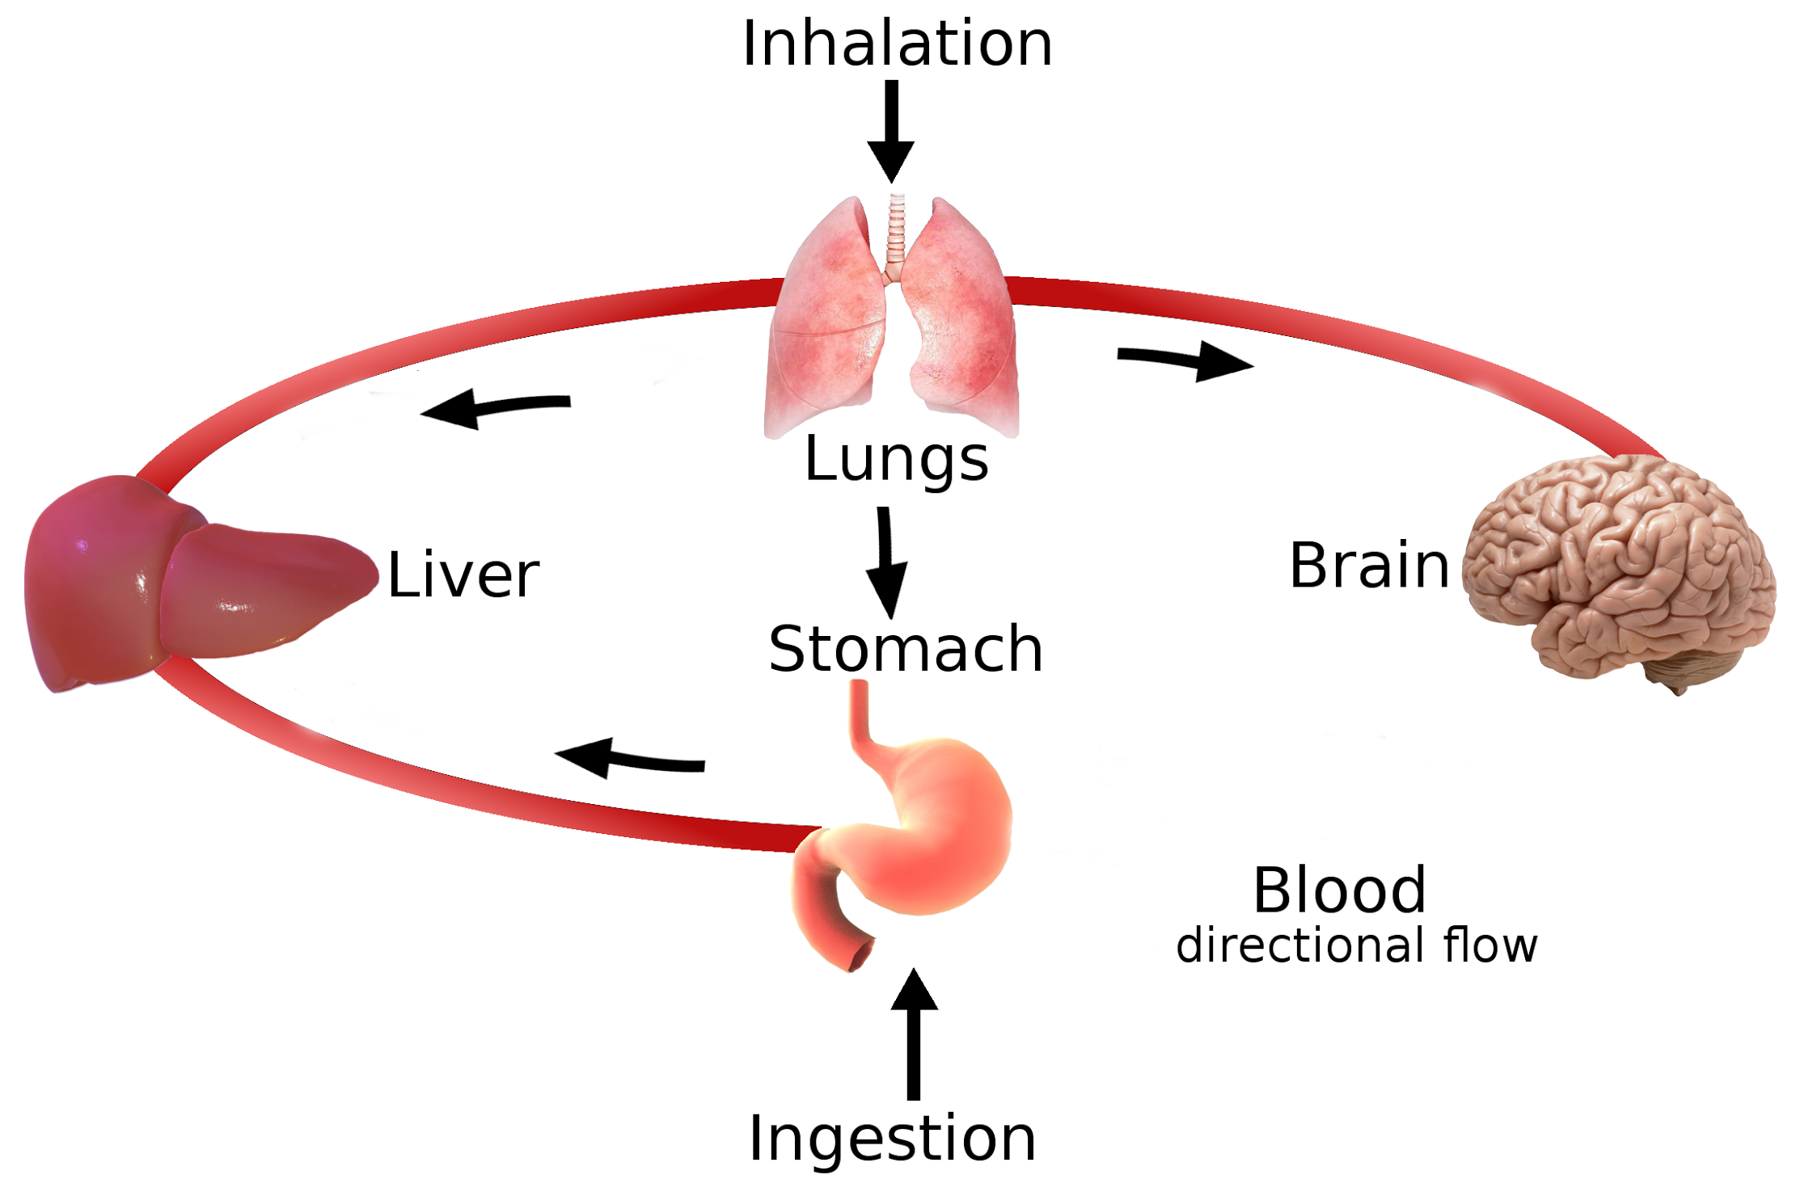
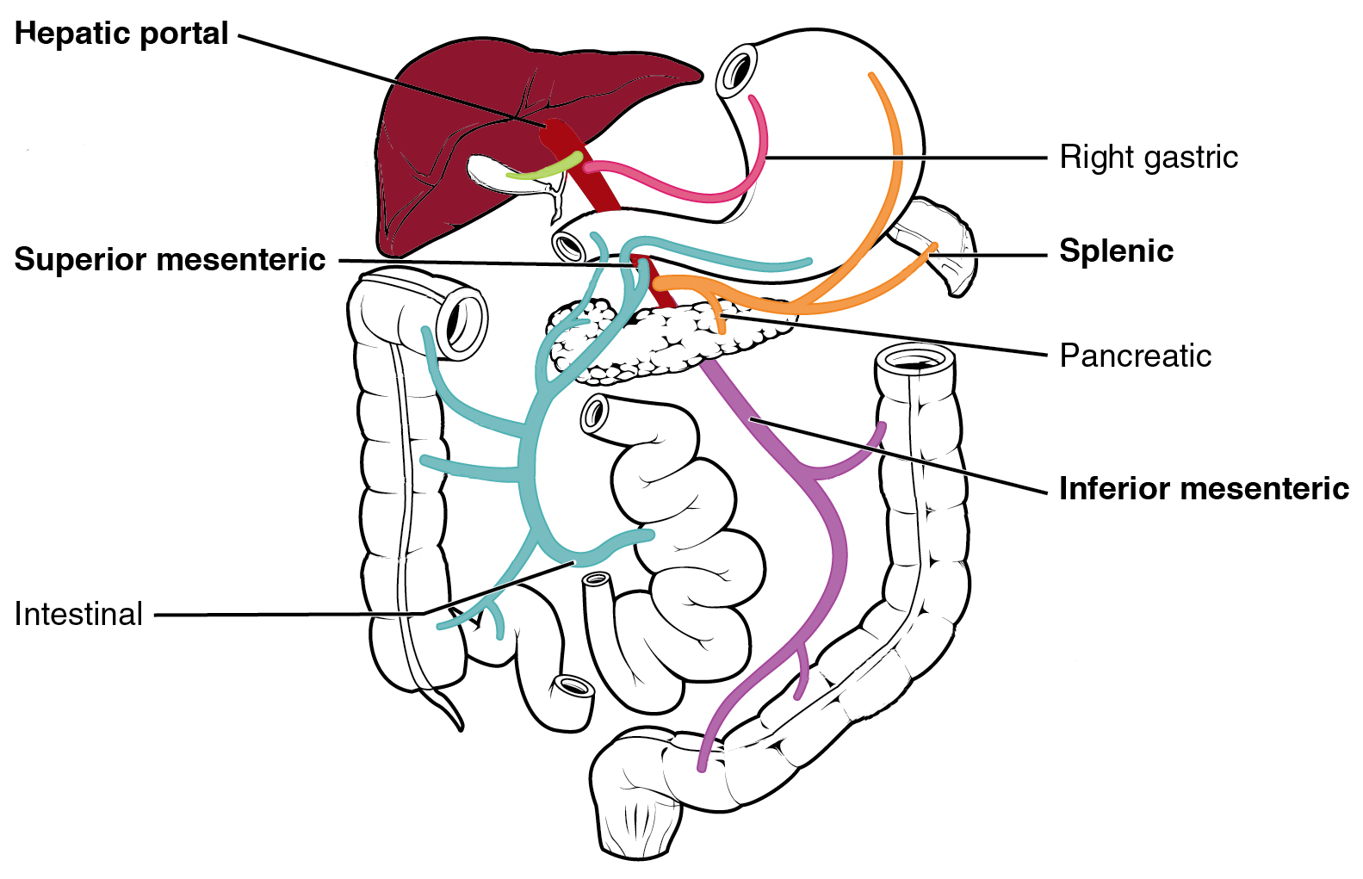
  Drug Ingestion via Lungs or Stomach
Inhaled THC is rapidly distributed to all organs
All blood from the digestive system, is filtered by the liver (site of most metabolism) before reaching other organs.
This is called “First Pass Metabolism”

Slide 12
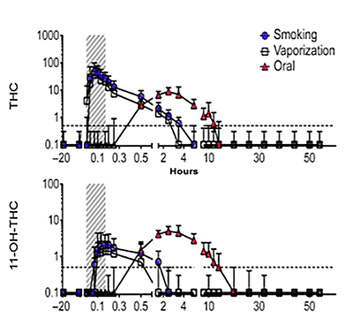
THC Pharmacokinetics
Comparison of THC absorption from cannabis (56 mg THC)
ug/L
11-OH THC: a marker of liver metabolism.
Oral administration results in more first pass metabolism
ug/L
Free and Glucuronide Whole Blood Cannabinoids' Pharmacokinetics after Controlled Smoked, Vaporized, and Oral Cannabis Administration in Frequent and Occasional Cannabis Users: Identification of Recent Cannabis Intake. Newmeyer et al. Clin Chem. 2016 62(12):1579-1592

Slide 13
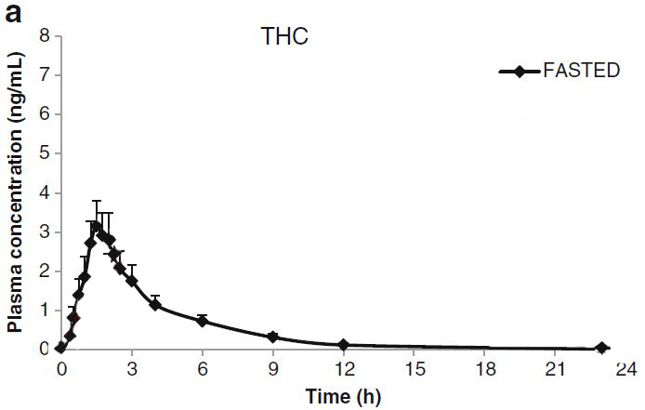
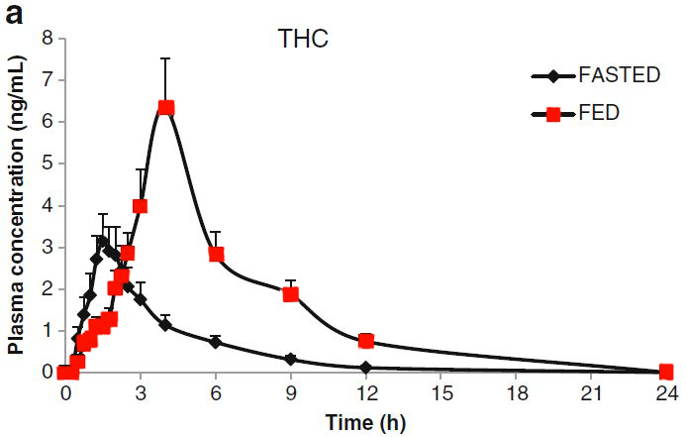
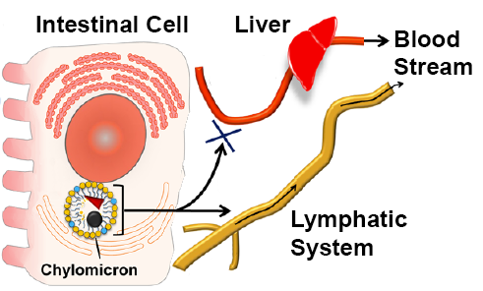
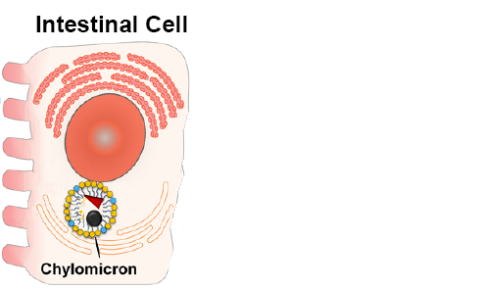
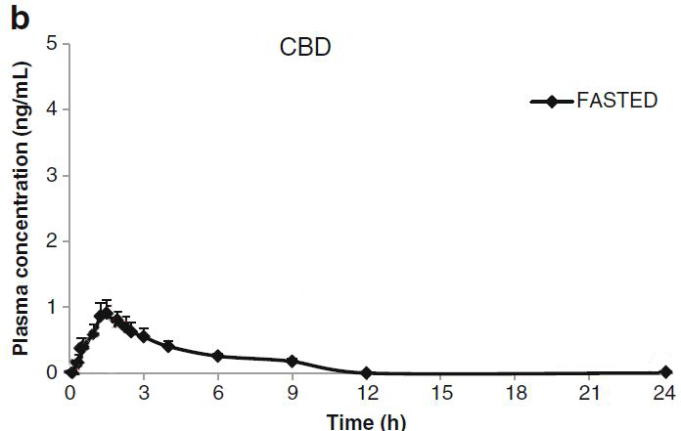
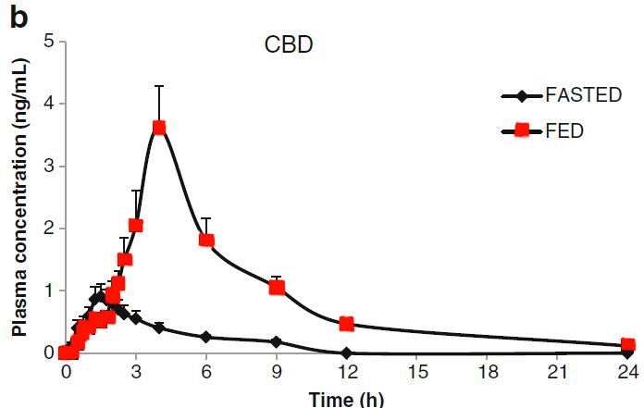
Effect of Food on CB Absorption
A fatty meal improves THC / CBD absorption by 200-300%*
THC/CBD is incorporated into fat droplets, absorbed by intestinal cells
The fat droplets are directed to the lymphatic system, and so bypass the liver#
*A phase I study to assess the effect of food on the single dose bioavailability of the THC/CBD oromucosal spray. Stott, C.G et al (2013). European journal of clinical pharmacology 69, 825-834.
#Dietary fats and pharmaceutical lipid excipients increase systemic exposure to orally administered cannabis and cannabis-based medicines Atheer Zgair et al (2016) Am J Transl Res. 8: 3448–3459

Slide 14
Cannabinoid Solubility Compared with Caffeine
Caffeine formulation* | mg/dose
Starbucks Latte (16oz/0.5L) | 150
Diet Coke (12oz/0.35L) | 46
Red Bull (8oz/0.25L) | 80
Cannabinoid oral dose | mg/dose
THC Low Dose | 5-15
THC Medium Dose | 15-30
THC High Dose | 40-100
CBD anxiolytic dose | 300
CBD antiseizure dose | ~1000-1500
Caffeine Solubility
Cold Water | 20,000 mg/L
Hot Water | 60,000 mg/L
Cannabinoid Solubility
Water (CBD/THC) | 2.8 mg/L#
CBD Pure Alcohol | 24,000 mg/L$
*Center for Science in the Public Interest
# Physiochemical properties, solubility, and protein binding of delta9-tetrahydrocannabinol. Garrett ER, Hunt CA. (1974) J Pharm Sci. 63(7):1056-64.
$WHO Expert Committee on Drug Dependence, 39th Meeting Geneva 2017

Slide 15
  Public Health Dangers of Cannabis Use
  Effects of THC include poor motor coordination, somnolence, cognitive impairment (learning, judgement and memory impairment)
  Most problematic in developing brains (teenagers), developmental cognitive concerns
  Associations with ADHD, Anxiety and Depression – Causative?
  Potential precipitation of psychotic episode in those predisposed. Synthetic CBs cause psychotic episodes
  THC use results in reduced ability to quit smoking and smoking impairs ability to quit cannabis
  Hyperemesis syndrome is becoming more commonly recognized in heavy users. There is no current treatment
  Cannabis somewhat increases the risk of opioid-induced respiratory depression (RD). The effect may be less intense than opioid plus alcohol or sleeping pill combinations

Slide 16
  Cannabinoids as Therapeutics

Slide 17
  Palliative Effects of Cannabinoids
  (Nausea and Analgesia)
Systematic Review and Meta-Analysis of Cannabinoids in Palliative Medicine. Mücke M et al 2018 J.Cachexia Sarcopenia Muscle, 9:220-234
The quality of evidence was low / very low mainly because of inadequate sample size and high number of non-completers
In HIV patients, cannabinoids were superior to placebo for both weight gain and appetite (mod effect size), but not for nausea/vomiting. There was a significant increase in mental health symptoms, but effect size was low
In cancer patients, No difference between cannabis and placebo for improving caloric intake, appetite or nausea/vomiting, sleep problems or the number of patients with a >30% reduction in pain. No difference in side effects (dizziness or mental health).

Slide 18
Opioid Sparing in Pain Patients
How well cannabinoids can reduce the dose of opioid needed for pain relief.
Opioid-Sparing Effect of Cannabinoids: A Systematic Review and Meta-Analysis. Nielsen et al 2017 Neuropsychopharmacology.;42(9):1752-1765.
This was a systematic review of available pre-clinical (animal) and clinical studies
17 of 19 pre-clinical studies provided evidence of synergistic effects from opioid and cannabinoid co-administration.
The median effective dose (ED50) of morphine in animals is 3.6 times lower when administered with delta-9-tetrahydrocannabinol
The 10 Clinical studies were of varying quality, half provided moderate to high quality evidence, and half were low or very low quality evidence quality evidence.
Only the v low quality (n=3) study showed opioid sparing effect.
Two low quality studies (no placebo) showed some improved pain, and improved sleep and overall functioning.
None of the 3 high quality, placebo controlled trials showed improved pain or opioid sparing

Slide 19
FDA approves first drug derived from marijuana (Cannabidiol) to treat rare, severe forms of epilepsy
Epidiolex was approved to treat Dravet’s and Lennox-Gastaut syndromes by FDA on June 25th 2018.
On 27th Sept. 2018 Epidiolex was scheduled by DEA as CV(5) – the lowest risk category of the Controlled Substances Act.
Currently other CBD formulations of CBD remain CI(1).

Slide 20
Epidiolex In Dravet’s Syndrome
(Clinical trials.gov ref= NCT02091375)
Dravet’s is a rare genetic condition starting in the first year of life.
Initially frequent fever-related seizures.
Later, other seizure types develop; myoclonic seizures (involuntary muscle spasms) and status epilepticus, (life-threatening, continuous seizures requiring emergency medical care).
High drug-resistance and mortality rate.
STUDY: 120 drug-resistant children and young adults received placebo or 20mg/kg CBD added to existing treatment regimen. (Note high dose)
RESULTS
Mean convulsive seizure frequency reduced by 23%, with median # decreasing from 12.4 to 5.9 in CBD group.
43% of CBD patients and 27% of placebo had >50% reduction in convulsive-seizure frequency
Adverse events included diarrhea, vomiting, fatigue, fever, somnolence, and elevated markers of liver impairment.
Drug interactions with Clobazam (a valium type antiseizure drug) were observed
*Trial of Cannabidiol for Drug-Resistant Seizures in the Dravet Syndrome. Devinsky et al N Engl J Med. 2017 May 25;376(21):2011-2020. (NCT02091375)

Slide 21
Epidiolex and Lennox-Gastaut Syndrome (Clinical trials.gov ref= NCT02224560)
Syndrome with frequent seizures starting between ages 3 and 5.
75% have tonic seizures, (uncontrollable muscle contraction). Absence and atonic (drop) seizures also common
Almost all children have learning problems and intellectual disability. Many have delayed motor skills development.
STUDY: 30 site double-blind, randomized, 225 patients (2 to 55 years) with two or more drop seizures / week
Treated with placebo, or Epidiolex; 5mg or 10 mg/kg x2/day for 14 weeks.
RESULTS
drop seizures averaged 85/28 day baseline period.
37% frequency reduction in 5 mg/kg group, 42% in 10mg/kg group
Common dose-related adverse events were somnolence, decreased appetite, and diarrhea and elevated liver enzymes
FDA has required post-marketing vigilance for liver injury, long term carcinogenicity and kidney function over next 2 years
Effect of Cannabidiol on Drop Seizures in the Lennox-Gastaut Syndrome. Devinsky et al N Engl J Med. 2018 May 17;378(20):1888-1897.

Slide 22
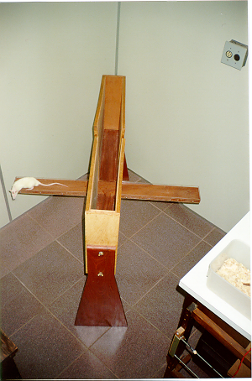
CBD Anxiolytic Effects
Most current anxiolytics are “Valium™”-type or “Prozac™ / Cymbalta™ type antidepressants.
CBD-induced anxiolysis appears to be mediated by serotonin receptor 1a.
Mostly preclinical studies (to date)
Elevated Maze Model

Slide 23
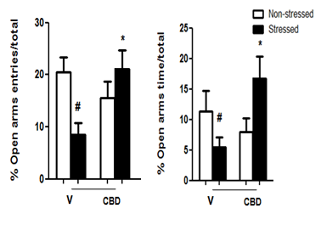
Chronic Unpredictable Stress Model
4. Substitution of sawdust with 37C water
5. Forced swim (10 min)
6. Removal of sawdust (24 h)
7. Light to dark shifts (four shifts of 30 min)
1. Food restriction
2. Restraint (2h)
3. Reversal light/dark cycle
The anxiolytic effect of cannabidiol on chronically stressed mice depends on hippocampal neurogenesis: involvement of the endocannabinoid system Campos AC, et al. Int J Neuropsychopharmacol. 2013 16(6):1407-19.

Slide 24
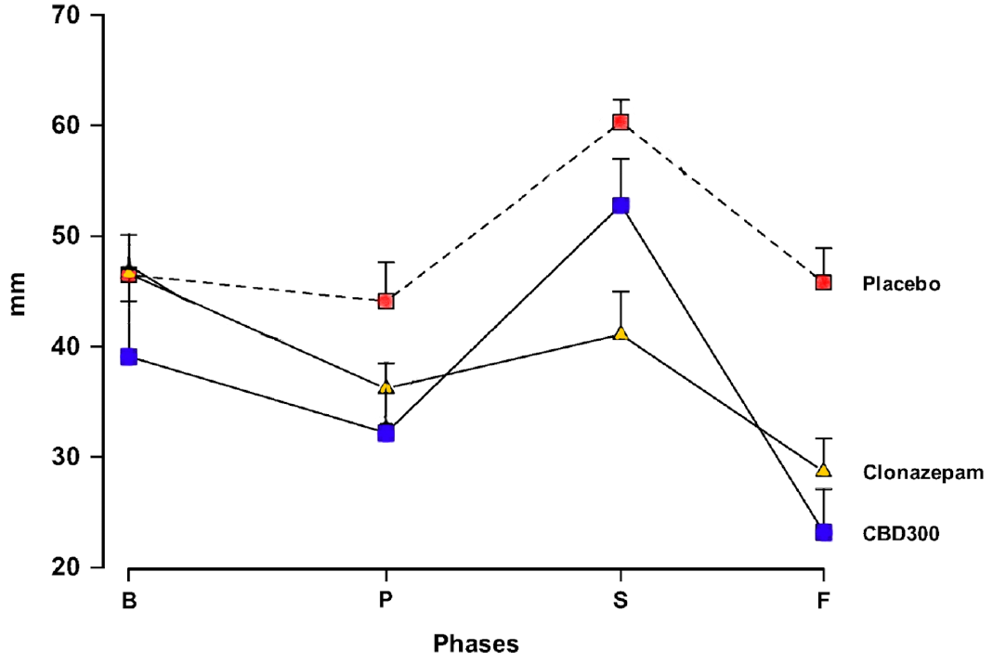
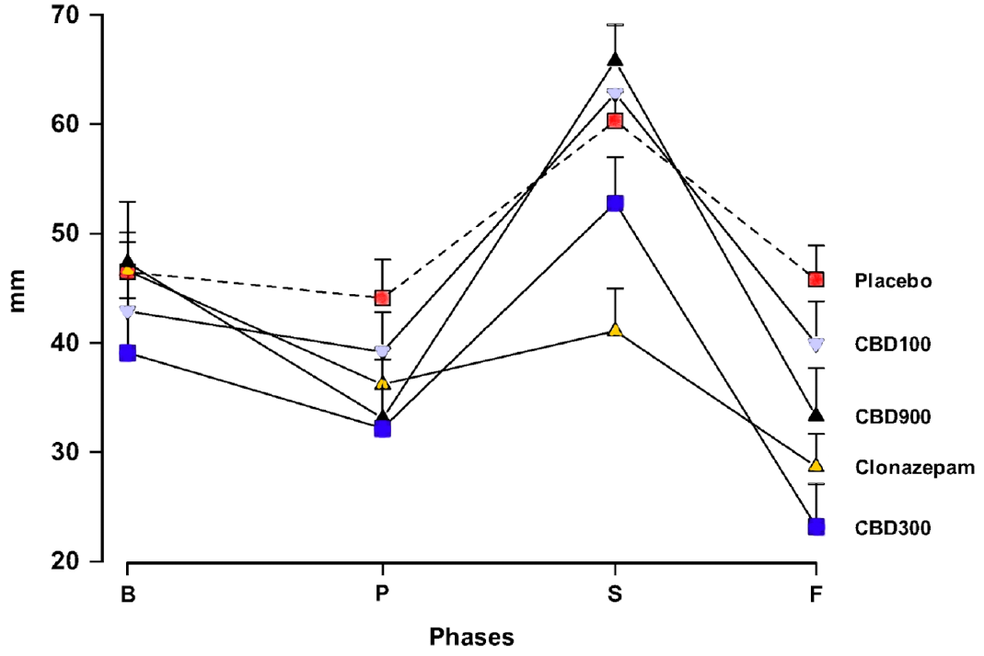
Effect of CBD in Healthy Subjects Simulated Public Speaking Test- More is NOT Better
Basal Pretest Speech F Post speech
Inverted U-Shaped Dose-Response Curve of the Anxiolytic Effect of Cannabidiol during Public Speaking in Real Life.
Zuardi et al (2017) Front Pharmacol. 2017 11;8:259

Slide 25
Closing Remarks
THC acts to mimic natural brain modulators of neurotransmission, but without temporal and regional specificity
Solubility of cannabinoids is poor in water, and so absorption of ingested cannabinoids is similarly poor and variable. Absorption can be improved if a fatty formulation is used
The analgesic and opioid sparing effects of THC are more pronounced in animal models than in humans
Cannabidiol is effective as anti-seizure drug but doses are high, and it affects metabolism of some other drugs and perhaps overall liver function
Cannabidiol shows promise as an anxiolytic, but shows a reversal of effect at high doses, perhaps because of opposing effects at different sites

Slide 26
Two known endocannabinoids
The role of 2-AG as a modulator of fast neurotransmission is clear.
The role of Anandamide is less clear. It appears to have “tonic” effects, ie longer term modulation effects, such as downregulation of stress
Anandamide
2-AG
Hillard, C.J., Beatka, M., and Sarvaideo, J. (2016). Endocannabinoid Signaling and the Hypothalamic-Pituitary-Adrenal Axis. Comprehensive Physiology 7, 1-15.

Slide 27
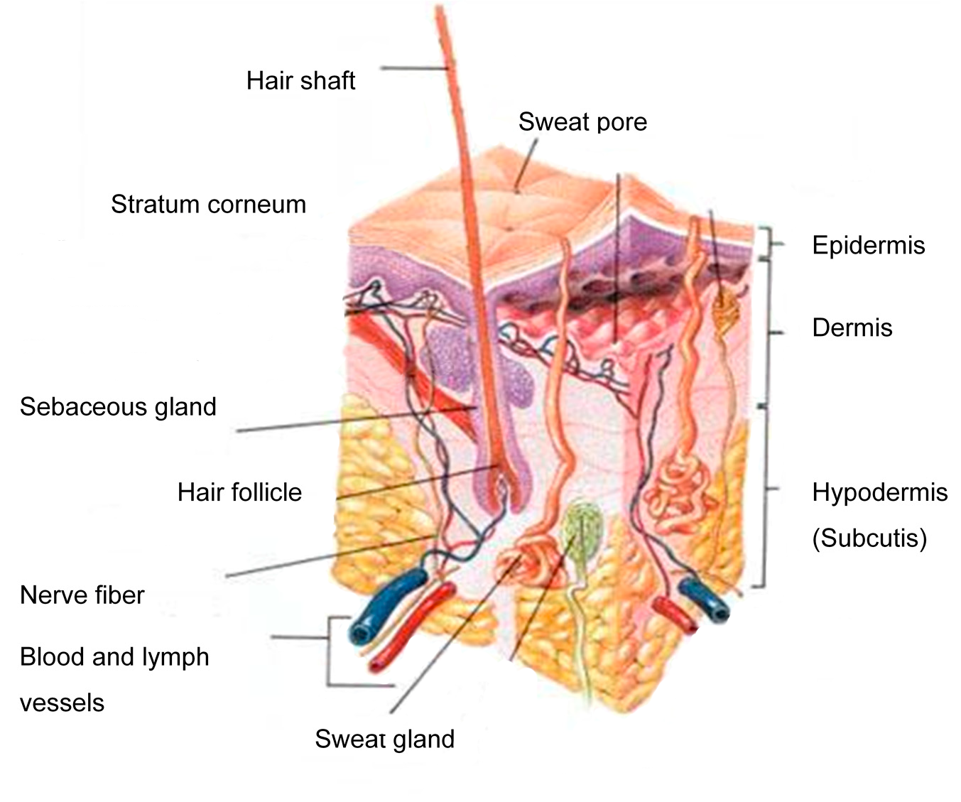
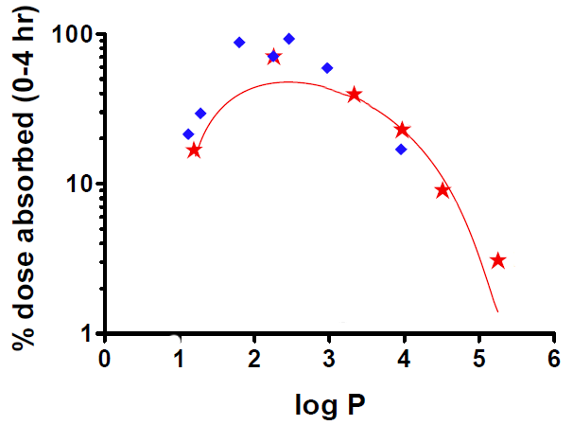
Transdermal Drug Delivery
Human Skin Structure
Waterproof “horny” outer layer, enriched in ceramides, so only fat soluble drugs penetrate
Needs to be somewhat water soluble to penetrate the water-rich dermis and blood vessels
Drug Penetration Depends on “Greasiness”
lidocaine
Efficient trans-dermal absorption generally requires a Log P of 1.5-4
testosterone
hydrocortisone
nicotine
THC/CBD
Log P ~ 5.5
(a measure of greasiness)

Slide 28
Symptoms of Cannabis Withdrawal
Withdrawal symptom | % (n) subjects reporting | Onset after quitting (days) (mean [SD]) | Peak intensity (mean [median])
Craving for cannabis | 59.4% (228) | 4.4 (0.9) | 4.4 (5.0)
Sleep difﬁculties | 50.5% (194) | 2.6 (4.9) | 3.8 (4.0)
Insomnia | 48.7% (187) | 2.7 (5.0) | 3.8 (4.0)
Feeling angry and/or aggressive and/or irritable | 45.6% (175) | 3.0 (5.5) | 3.9 (4.0)
Feeling anxious, “nervous” | 38.5% (148) | 3.4 (6.5) | 3.6 (3.0)
Change in appetite | 36.4% (140) | 3.7 (5.9) | 3.9 (4.0)
Feeling sad, depressed | 34.4% (132) | 4.0 (6.7) | 3.7 (4.0)
Feeling angry and/or aggressive | 33.9% (130) | 2.8 (5.4) | 3.9 (4.0)
Feeling irritable, “jumpy” | 29.4% (113) | 3.3 (6.1) | 3.7 (4.0)
Feeling angry | 28.9% (111) | 3.1 (5.7) | 3.9 (4.0)
Physical symptom | 25.3% (97) | 3.1 (5.0) | 3.6 (4.0)
Feeling restless | 21.9% (84) | 2.8 (4.4) | 3.7 (4.0)
Feeling aggressive | 20.1% (77) | 3.6 (5.6) | 3.8 (4.0)
Weight loss and/or decreased appetite | 20.8% (80) | 4.9 (8.1) | 3.5 (4.0)
Increased appetite | 20.8% (80) | 3.3 (6.1) | 4.0 (4.0)
Decreased appetite | 17.4% (67) | 4.0 (7.3) | 3.6 (4.0)
*Diagnostic criteria for cannabis withdrawal syndrome. Gorelick, D.A., et al (2012). Drug and alcohol dependence 123, 141-147.

Slide 29
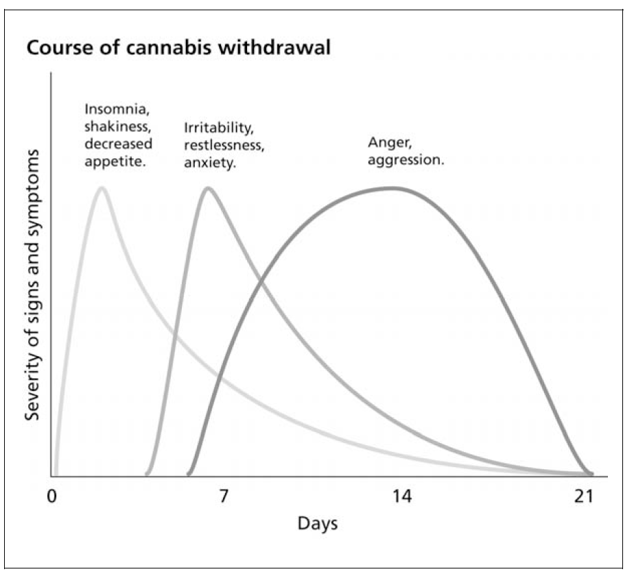
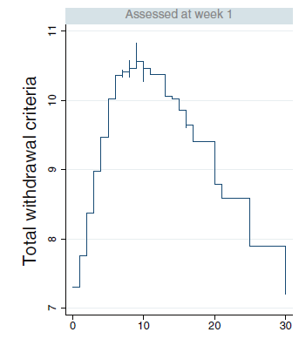
Cannabis
Withdrawal Time Course
Total Sum Withdrawal
Day
NSW Drug and Alcohol Withdrawal Clinical Practice Guidelines. Mental Health and Drug & Alcohol Office, NSW Department of Health, Australia 2008
Time-course of the DSM-5 cannabis withdrawal symptoms in poly-substance abusers Hesse and Thylstrup BMC Psychiatry 2013, 13:258

Slide 30
Opioid Sparing
Effect of Cannabis Use in People With Chronic Non-Cancer Pain Prescribed Opioids: Findings From a 4-year Prospective Cohort Study. Campbell et al 2018 Lancet Public Health; 3:e341-e350.
Prospective observational study to investigate cannabis use in people with chronic pain prescribed opioids, examined reasons for use, perceived effectiveness and potential opioid-sparing effects.
Results: Cannabis use was common (24% over 4 yr period).
Cannabis users had slightly increased risk of greater pain score
No evidence of improved patient outcomes.
No evidence of opioid sparing.

Slide 31
  Neuropathic Pain
Cannabis-Based Medicines for Chronic Neuropathic Pain in Adults. Mücke M et al 2018 Cochrane Database Syst Rev. Mar 7;3:CD012182
Review of 16 studies / 1750 participants. 2 to 26 weeks long,
Sativex/nabiximols (THC:CBD spray (10 studies)
nabilone ( 2 studies),
inhaled herbal cannabis (2 studies)
dronabinol (2 studies).
Modest increase in # of people achieving >30% pain relief (39% vs 33%) NNT 11, (1586 participants, 10 studies, moderate quality evidence).
Cannabis-based medicines may increase nervous system adverse events compared with placebo (61% vs 29%)
Psychiatric disorders occurred in 17% vs 5% using placebo NNTH 3, 1304 participants, 9 studies, low-quality evidence).

Slide 32
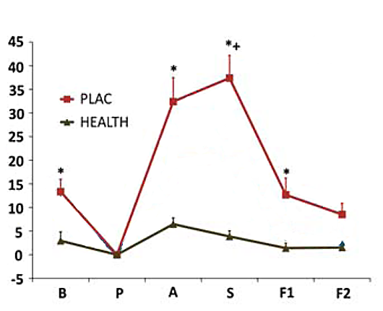
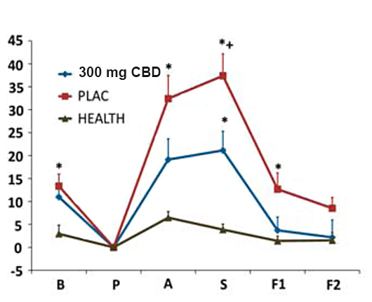
Effect of CBD in 12 Social Anxiety Patients: Simulated Public Speaking Test
Basal Pretest Anticipation Speech F1+F2 Post speech Measures
Cannabidiol reduces the anxiety induced by simulated public speaking in treatment-naive social phobia patients. Bergamaschi, et al. (2011) Neuropsychopharmacology 36, 1219-1226

